Slide 1
Scientific Method DEVELOPING an HYPOTHESIS "The Art of Educated Guessing“ or "From Question to Testable Prediction".
Never forget to name the people who developed at least part of the material you use
Nelson Baloian
ShaliniPrasad
Ajith Rao
Eeshoo Rehani
Gordana DODIG-CRNKOVIC

Slide 2

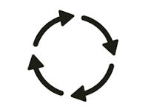


Goals of this unit
Understand the role of a hypothesis.
See it as an evolutionary process.
Draft your first formal hypothesis.
Learn how to test it.
Outline your experiment.

Slide 3
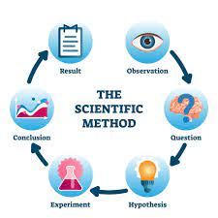
The Scientific Method: A Cycle of Inquiry
Is the logical scheme used by scientists searching for answering to the questions posed within science.
Scientific method is used to produce scientific theories

Slide 4
Steps (simplified)
Pose the research question(s) in the context of existing knowledge (theory & observations)
Formulate a hypothesis as a tentative answer
Deduce consequences and make predictions
Test the hypothesis in a specific experiment/theory field.

Slide 5
Warning
As a rule, the loop 2-3-4 is repeated with modifications of the hypothesis until the agreement is obtained, which leads to 5 (next step, comes in the next slide)
If major discrepancies are found the process must start from the beginning, 1.

Slide 6

Steps (5 and final)
When consistency is obtained the hypothesis becomes a theory (thesis!!!)
Results have to be published and is subject of process of ”natural selection” among competing theories

Slide 7
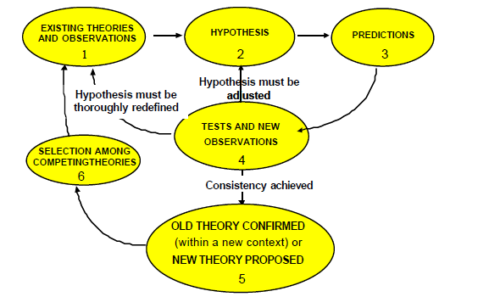
Diagram describing iterative nature of the hypothetico-deductive method

Slide 8
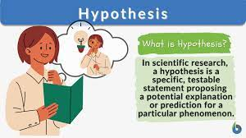
Let's Go to the Hypothesis (The Heart of the Matter)

Slide 9
Other definitions of hypothesis
“It is a tentative prediction about the nature of the relationship between two or more variables.”
“A hypothesis can be defined as a tentative explanation of the research problem, a possible outcome of the research, or an educated guess about the research outcome.”
“Hypotheses are always in declarative sentence form, and they relate, either generally or specifically , variables to variables.”
“An hypothesis is a statement or explanation that is suggested by knowledge or observation but has not yet been proved or disproved”

Slide 10
What is a Hypothesis? Our definition
"An educated guess that proposes a testable explanation for an observed phenomenon."
"Educated" (based on research),
"Guess" (proposed explanation),
"Testable" (can be proven true/false) around it.
It's not just any guess. It's 'educated' because you've done some background research. And most importantly, you must be able to test it.

Slide 11
Nature of a Hypothesis
The hypothesis is a clear statement of what is intended to be investigated.
It allows to:
Identify the research objectives
Identify the key abstract concepts involved in the research
Identify its relationship to both the problem statement and the literature review
A problem cannot be scientifically solved unless it is reduced to hypothesis form
It is a tool of advancement of knowledge, consistent with existing knowledge

Slide 12
Nature of a Hypothesis
It can be tested –verifiable or falsifiable
Hypotheses are not moral or ethical questions
It is neither too specific nor to general
It is a prediction of consequences
It is considered valuable even if proven false

Slide 13
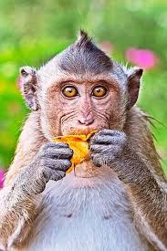
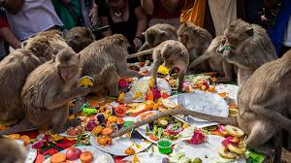
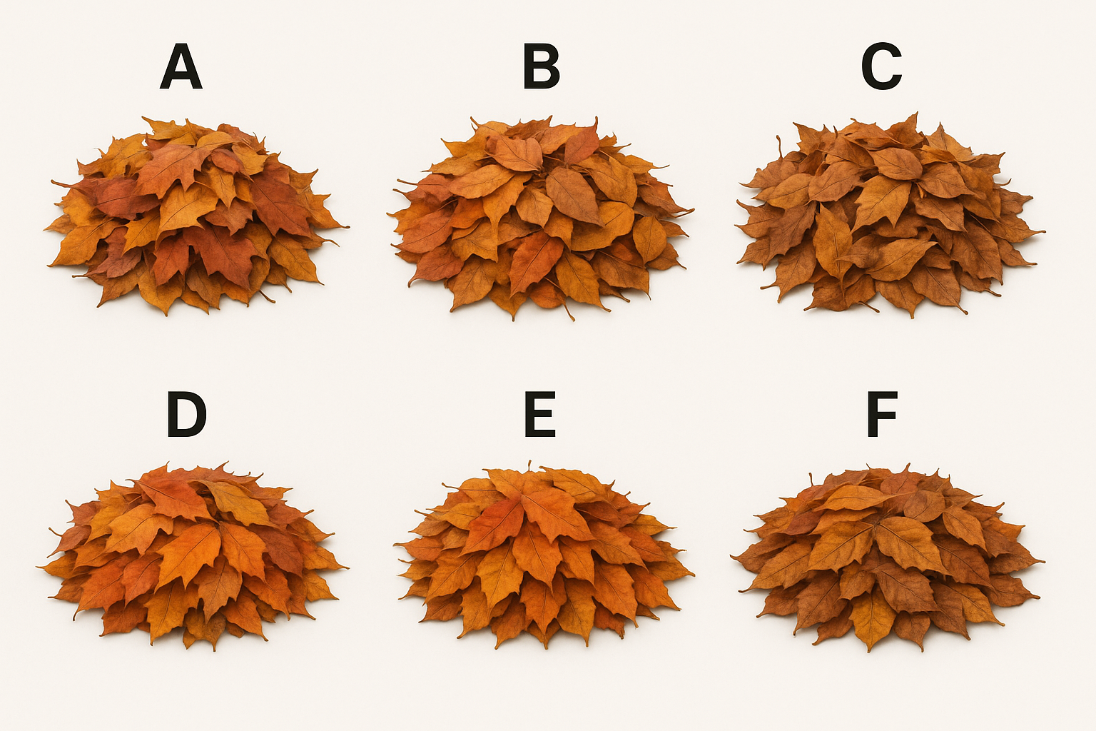
An Example…
A nutritionist in a zoo must develop a menu plan for the group of monkeys. Choices available include leaves of species A B C D E and F. It is known that in the wild monkeys eat mainly B, but you suspect that this could be because they feel safe whilst feeding in B trees, whereas eating any of the other species would make them vulnerable to predation. You design an experiment to find out which type of leaf the monkeys like best: You offer the monkeys all five types of leaves in equal quantities and observe what they eat.

Slide 14
… and the hypothesis
There are many different experimental hypotheses we could formulate for the study. For example:
When offered all five types of leaves, the monkeys will preferentially feed on B leaves.
This statement satisfies both criteria for experimental hypotheses. It is a
Prediction: It predicts the anticipated outcome of the experiment
Testable: Once you have collected and evaluated your data (i.e. observations of what the monkeys eat when all six types of leaves are offered), you know whether or not they ate more B leaves than the other types.

Slide 15
Incorrect hypotheses
When offered all five types of leaves, the monkeys will preferentially eat the type they like best.
This statement is predictive, but there is no way you can test whether it is true with this study. Data will show whether monkeys preferred one type of leaf, but not why they like it best
When offered all five types of leaves, the monkeys will preferentially eat B leaves because they can eat these safely in their natural habitat.
the second part ('because they can eat these safely in their natural habitat') fails to satisfy the criterion of testability. You can tell whether the monkeys preferentially eat B leaves, but this experiment cannot tell why.

Slide 16
Incorrect hypotheses
In their natural habitat, monkeys that feed in B trees are less vulnerable to predation than monkeys that feed on A, C, D, or E.
good experimental hypothesis, but not for the experiment described in the question. For this hypothesis, a study in the wild looking at how many monkeys get killed by predators whilst feeding on the leaves of A, B etc. is necessary.
When offered all five types of leaves, which type will the monkeys eat preferentially?
This is a question, and questions fail to satisfy criterion #1: They are not predictive statements. Hence, a question is not a hypothesis.

Slide 17
In short:
✅ GOOD HYPOTHESIS | ❌ INCORRECT
"When offered all five leaves, the monkeys will eat more B leaves than others." - Predictive: Says what will happen. - Testable: You can count and compare. | "They will eat what they like best." - Not Testable: "Like" is not measurable.
 | "...because they feel safe." - Not Testable: This experiment can't test the "why".
 | "Which will they eat?" - A Question, not a prediction.

Slide 18
Crafting a Strong Hypothesis: The Formula
IF: [Independent Variable] (What you change)
THEN: [Dependent Variable] (What you measure)
BECAUSE: [Your logical reasoning]
Example: "IF monkeys prefer leaves based on taste alone (IV=leaf type), THEN they will eat more B leaves (DV=amount eaten) when safety is equal, BECAUSE prior observation shows B is their main food source."

Slide 19
Types of Hypotheses
Null Hypothesis (H₀): "The default assumption. It states there is no effect or no relationship." (e.g., "The vaccine has no effect on antigen count.")
Alternative Hypothesis (H₁ or Hₐ): "What the researcher believes to be true. It states there is an effect or a relationship." (e.g., "The vaccine increases the antigen count.")
Key Point: "We test the data to see if we can reject the null hypothesis."

Slide 20
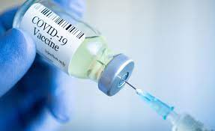
EXAMPLE
We want to do a clinical trial of a new vaccine, to proof it generates protection to the population who receives it
We would write H0:
On average the new vaccine has no effect on the number of antigens people develop.
The alternative hypothesis might be that the new vaccine has an effect on people who are inoculated.
We would write H1:
People inoculated with the new vaccine develop in average, x% or more antigens than those who are not.

Slide 21
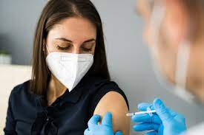

EXPERIMENT
Gather two groups of people with similar characteristics
Experimental group: those who receive the vaccine
Control Group: those who get a placebo
After some time get the number of antigens in both groups
Apply statistical methods to check if there is a significant difference in the results for both groups
More examples everywhere in the web:
https://helpfulprofessor.com/hypothesis-examples/

Slide 22
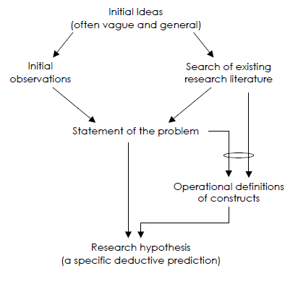
Generation of Research Hypothesis
1. Initial Ideas: The process starts with broad curiosity—a general question or a vague idea about how something works. "I wonder how social media affects people's happiness?“
2. Initial Observations: Informal noticing of patterns or behaviors in the world provides initial support for the idea. "I've noticed that my friends who spend a lot of time on Instagram seem to report feeling more anxious or dissatisfied.“
3. Literature Search: The researcher then explores existing scientific studies to understand current knowledge and identify gaps their work could fill. Searching for studies on "social media use and well-being," "Facebook and depression," or "Instagram and self-esteem.“
4. Problem Statement: Based on the literature, a specific, focused research problem is formally defined. "While previous research has established a correlation between social media use and decreased well-being, there is a lack of experimental research on whether limiting daily Instagram use leads to a measurable increase in life satisfaction in young adults.“

Slide 23
Generation of Research Hypothesis
5. Operational Definitions: This is a critical step. Abstract concepts (e.g., "happiness," "social media use") are defined in precise, measurable terms.
Construct: "Instagram Use" -> Operationalized as: "Total minutes spent on the Instagram app per day, as tracked by iPhone's Screen Time feature."
Construct: "Life Satisfaction" -> Operationalized as: "A participant's total score on the Satisfaction with Life Scale (SWLS), a standardized 5-question survey."
6. Research Hypothesis : The final output is a specific, deductive prediction. It clearly states the expected relationship between the measurable variables defined in the previous step. "Young adults (aged 18-25) who are instructed to limit their Instagram use to less than 30 minutes per day for a period of four weeks will report a significantly higher score on the Satisfaction with Life Scale (SWLS) at post-test than a control group who continues their usage unrestricted."

Slide 24
Hypothesis testing is a four-step procedure:
Stating the hypothesis
(Null and/or Alternative)
Setting the criteria for a decision
Collecting data
Evaluate the Null hypothesis

Slide 25
Errors in Hypotheses
Two types of mistakes are possible while testing the hypotheses.
 | H₀ is TRUE (Vaccine doesn't work) | H₀ is FALSE (Vaccine works)
We REJECT H₀ (We say it works) | ❌ Type I Error "False Alarm" | ✅ Correct
We FAIL TO REJECT H₀ (We say it doesn't work) | ✅ Correct | ❌ Type II Error "Missed Opportunity"

Slide 26
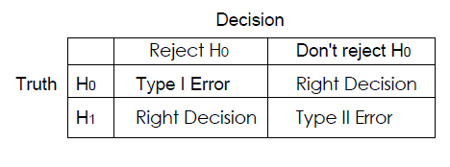
To generalize
A type I error is often considered to be more serious, and therefore more important to avoid, than a type II error.

Slide 27
Explanation
Type I Error:
A type I error occurs when the null hypothesis (H0) is wrongly rejected.
For example, A type I error would occur if we concluded that the new vaccine produces more antigens when in fact there was no difference between the groups.
Type II Error:
A type II error occurs when the null hypothesis H0, is not rejected when it is in fact false.
For example: A type II error would occur if it were concluded that the new vaccine does not produce more antigens when in fact the experimental group had more.

Slide 28
Summary
“Research questions and hypotheses become “signposts” for explaining the purpose of the study & guiding the research…”,
A hypothesis is an explanation, tentative and unsure of itself, for specific phenomena about which you have questions.
A well-crafted hypothesis very often suggests the best way to perform the research and gives you clues as to your research design.
“hypothesis is perhaps the most powerful tool, man has invented to achieve dependable knowledge” –Fred Kerlinger…

